Slide 1
SEPM – Unit V
Week 4 - Schedule
Product Release
Release Planning
Product Release Management Product Implementation
Release Management cycle
User Training

Slide 2
Product Release
A product release is the process of launching a new product for a specific market or user base.
In software development, a product release is sometimes done with a beta version so that core developers/users can assist with debugging and feedback prior to the release of the actual software.

Slide 3
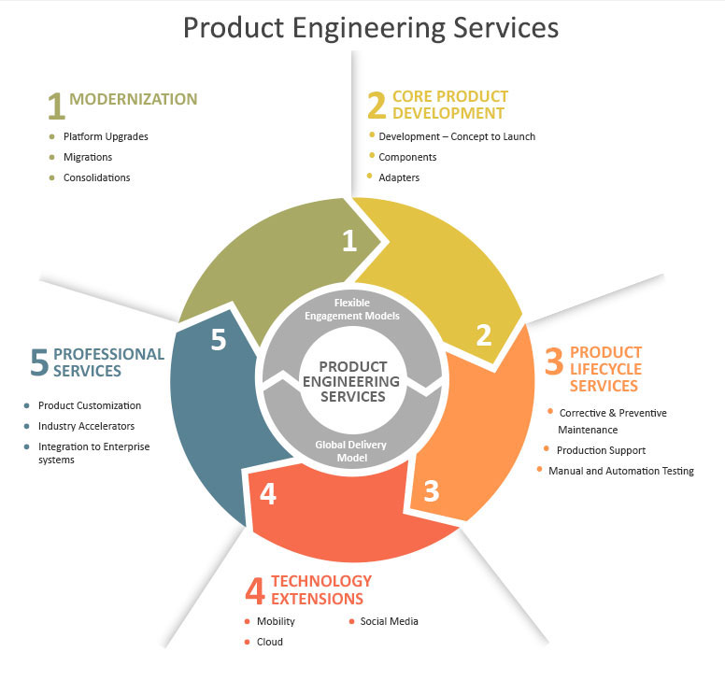
Product Release

Slide 4
Release Planning
Release planning refers to the planning process that surrounds the release of a software program or technology product.
It is critical to ensuring smooth migration from internal testing to a customer use environment.

Slide 5
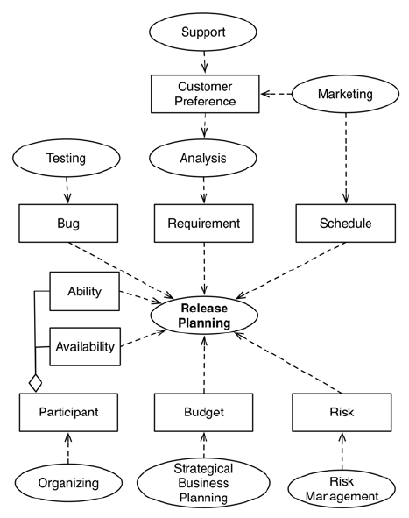
Release Planning

Slide 6
Product Release Management
Release management is the process of managing, planning, scheduling and controlling a software build through different stages and environments; including testing and deploying software releases.
While release management processes may vary and should be customized for each organization, there are five primary steps to release management.
1. Plan release.
2. Build release.
3. User acceptance testing.
4. Prepare release.
5. Deploy release.

Slide 7
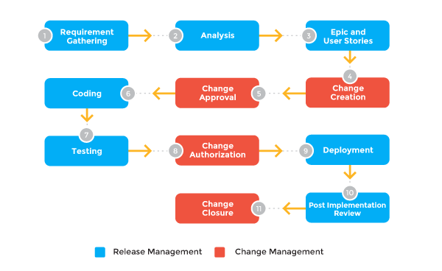
Product Release Management

Slide 8
Product Release Management
7 Ways to Improve Your Software Release Management
Understand the current state of release management. ...
Establish a regular release cycle. ...
Get lightweight processes in place. ...
Establish a release infrastructure early. ...
Automate and standardize as much as you can. ...
Establish positive expectations. ...
Invest in people.

Slide 9
Product Release Management
Release and Change Management:
Change Management is a governance process, the role of the Change Manager is to review, authorise and schedule the Change.
Release Management is an installation process. It works with the support of Change Management to builds, tests and deploy new or updated services into the live environment.

Slide 10
Product Release Management
Scope of Release Management :
Scope of Release Management - Release Management undertakes the planning, design, build, configuration and testing of hardware and software to create a set of Release components for a live environment. Activities also cover the planning, preparation and scheduling of a Release to many Customers and locations.

Slide 11
Product Release Management
The best Release Management tools:
Automic. Automic helps enterprises drive competitive advantage by automating their IT and business systems – from on-premise to the Cloud, Big Data and the Internet of Things.
BMC Release Process. ...
CA Release. ...
CA Release Automation. ...
Mirco Focus Release. ...
Plutora. ...
UrbanCode Release. ...
XL Release.

Slide 12
Product Implementation
Product implementation is the first process encountered in the SE engine that begins the movement from the bottom of the product hierarchy up towards the Product Transition Process.
This is where the plans, designs, analysis, requirements development, and drawings are realized into actual products.

Slide 13
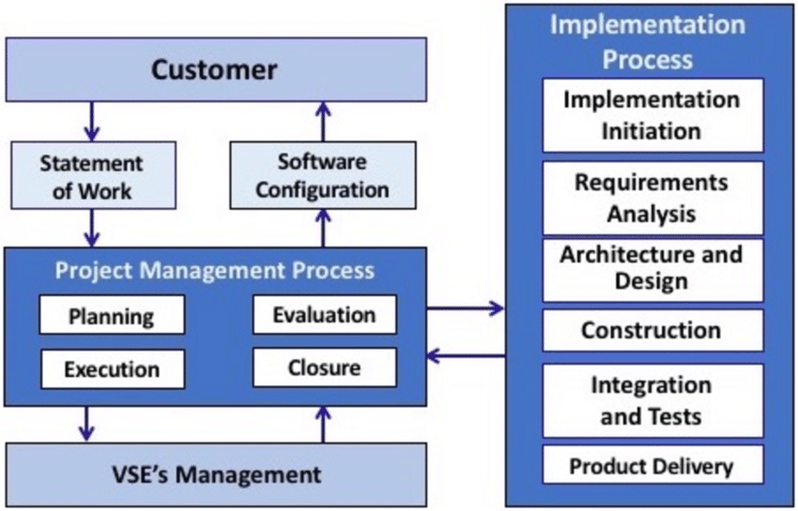
Product Implementation

Slide 14
Product Implementation
Here are the steps we'll cover:
1. Keep Vendors Accountable With a Detailed Needs Document.
2. Control Your Scope—Or It Will Control You.
3. Assign Realistic Teams to Drive Software Implementation Plan.
4. Generate User Adoption With a Proactive, Engaging Strategy.
5. Focus on Continuous Improvement.

Slide 15
Product Implementation
5 Key Factors to Implementation Project Success:
1. Set and Manage Realistic Expectations. The process of evaluating requirements and implementing a project is demanding.
2. Establish Common Goals Among the Team.
3. Define a Realistic Budget and Schedule.
4. Maintain Management Commitment.
5. Participate in Executive Level Discourse.

Slide 16
Release Management cycle
Release management is a software engineering process intended to oversee the development, testing, deployment and
support of software releases.
Release management usually begins in the development cycle with requests for changes or new features.
If the request is approved, the new release is planned and designed.

Slide 17
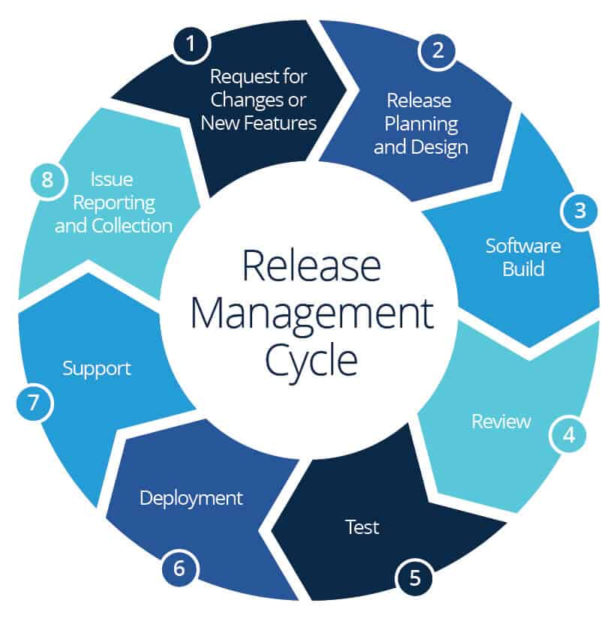
Release Management cycle

Slide 18
User Training
Software Release UserTraining:
Examples of training for end users on new releases of software.
Software Release Notes Documentation and Templates — Examples of release notes and documentation provided for specific software releases, and templates you can use to create your own release notes.

Slide 19
User Training
Training methods to learn new software and systems
1. Trainers need to know the software or system themselves.
2. Make training a priority to improve buy-in.
3. Set clear and realistic deadlines and rollout methods.
4. Use training incentives for employees to use new software.
5. Pick the right format for training.

Slide 20
User Training
User Training can truly help with implementation of a new system at a company and ensure maximum efficiency right from the start.
The IT provider can train users on their software system in a few hours and can always provide support after implementation if employees have any questions at a later date.

Slide 21
User Training
Key Objectives of Training Employees
Increase Efficiencies in Processes. The main purpose of training is to ensure that all employees have the technical skills needed to perform the job efficiently and smoothly.
Increase Motivation and Engagement.
Reduce Employee Turnover.
Upskill Employees.
Risk Management.

